Slide 1
Statistical Methods for Data Analysis
Parameter estimates with RooFit
Luca Lista
INFN Napoli

Slide 2
Fits with RooFit
Get data sample (or generate it, for Toy Monte Carlo)
Specify data model (PDF’s)
Fit specified model to data set with preferred technique (ML, Extended ML, …)

Slide 3
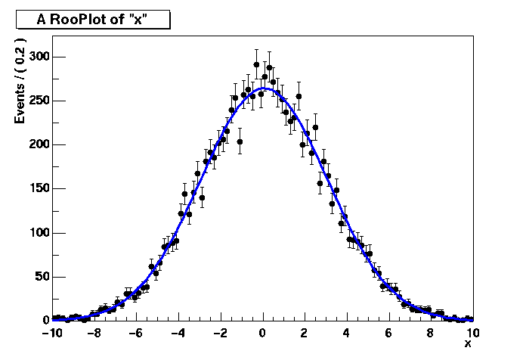
Example
RooRealVar x("x","x",-10,10) ;
RooRealVar mean("mean","mean of gaussian",0,-10,10);
RooRealVar sigma("sigma","width of gaussian",3);
RooGaussian gauss("gauss","gaussian PDF",x,mean,sigma);
RooDataSet* data = gauss.generate(x,10000);
// ML fit is the default
gauss.fitTo(*data);
mean.Print();
// RooRealVar::mean =
// 0.0172335 +/- 0.0299542
sigma.Print();
// RooRealVar::sigma =
// 2.98094 +/- 0.0217306
RooPlot* xframe = x.frame();
data->plotOn(xframe);
gauss.plotOn(xframe);
xframe->Draw();
Further drawing options:
pdf.paramOn(xframe,data);
data.statOn(xframe);
PDF
automatically
normalized
to dataset

Slide 4
Extended ML fits
Specify extended ML fit adding one extra parameter:
  pdf.fitTo(*data, RooFit::Extended(kTRUE));

Slide 5
Import external data sets
Read a ROOT tree:
  RooRealVar x(“x”,”x”,-10,10);
  RooRealVar c(“c”,”c”,0,30);
  RooDataSet data(“data”,”data”,inputTree,
  RooArgSet(x,c));
  Automatic removal of entries out of variable range
Read an ASCII file:
  RooDataSet* data =
  RooDataSet::read(“ascii.file”,
  RooArgList(x,c));
  Une line per entry; variable order given by argument list

Slide 6
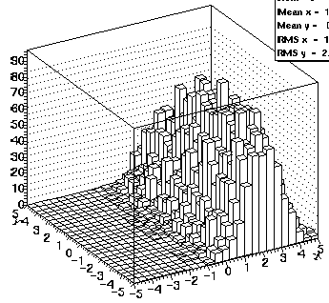
Histogram fits
Use a binned data set:
  RooDataHist instead of RooDataSet
Fit with binned
model
Unbinned
Binned
x | y | z
1 | 3 | 5
2 | 4 | 6
1 | 3 | 5
2 | 4 | 6
RooDataSet
RooDataHist
RooAbsData

Slide 7
Import external histograms
From ROOT TH1/TH2/TH3:
  RooDataHist bdata1(“bdata”,”bdata”,RooArgList(x),histo1d);
  RooDataHist bdata2(“bdata”,”bdata”,RooArgList(x,y),histo2d);
  RooDataHist bdata3(“bdata”,”bdata”,RooArgList(x,y,z),histo3d);
Binning an unbinned data set:
  RooDataHist* binnedData = data->binnedClone();
Specifying binning:
  x.setBins(50);
  RooDataHist binnedData(“binnedData”, “data”, RooArgList(x), *data);

Slide 8
Discrete variables
Define categories
E.g.: b-tag:
  RooCategory b0flav("b0flav", "B0 flavour");
  b0flav.defineType("B0", -1);
  b0flav.defineType("B0bar", 1);
Several tools defined to combine categories (RooSuperCategory) and analyze data according to categories
  See Root user manual for more details…
Switch between PDF’s based on a category can be implemented for simultaneous fits of multiple categories:
  RooSimultaneous simPdf("simPdf","simPdf", categoryType);
  simPdf.addPdf(pdfA,"A");
  simPdf.addPdf(pdfB,"B");
Indices automatically assigned
if omitted

Slide 9
Explicit Minuit minimization
Build negative log-Likelihood finction (NLL)
  // Construct function object representing -log(L)
  RooNLLVar nll(“nll”, ”nll”, pdf, data);
  // Minimize nll w.r.t its parameters
  RooMinuit m(nll);
  m.migrad();
  m.hesse();
Extra arguments: specify extended likelihood:
  RooNLLVar nll(“nll”,”nll”,pdf,data,Extended());
Chi-squared functions (only accepts RooDataHist):
  RooNLLVar chi2(“chi2”,”chi2”,pdf,data);

Slide 10
Drive converging process
// Start Minuit session on above nll
RooMinuit m(nll);
// MIGRAD likelihood minimization
m.migrad();
// Run HESSE error analysis
m.hesse();
// Set sx to 3, keep fixed in fit
sx.setVal(3);
sx.setConstant(kTRUE);
// MIGRAD likelihood minimization
m.migrad();
// Run MINOS error analysis
m.minos();
// Draw 1,2,3 ‘sigma’ contours in sx,sy
m.contour(sx, sy);

Slide 11
Minuit function MIGRAD
Purpose: find minimum
Progress information,
watch for errors here
**********
** 13 **MIGRAD 1000 1
**********
(some output omitted)
MIGRAD MINIMIZATION HAS CONVERGED.
MIGRAD WILL VERIFY CONVERGENCE AND ERROR MATRIX.
COVARIANCE MATRIX CALCULATED SUCCESSFULLY
FCN=257.304 FROM MIGRAD STATUS=CONVERGED 31 CALLS 32 TOTAL
EDM=2.36773e-06 STRATEGY= 1 ERROR MATRIX ACCURATE
EXT PARAMETER STEP FIRST
NO. NAME VALUE ERROR SIZE DERIVATIVE
1 mean 8.84225e-02 3.23862e-01 3.58344e-04 -2.24755e-02
2 sigma 3.20763e+00 2.39540e-01 2.78628e-04 -5.34724e-02
ERR DEF= 0.5
EXTERNAL ERROR MATRIX. NDIM= 25 NPAR= 2 ERR DEF=0.5
1.049e-01 3.338e-04
3.338e-04 5.739e-02
PARAMETER CORRELATION COEFFICIENTS
NO. GLOBAL 1 2
1 0.00430 1.000 0.004
2 0.00430 0.004 1.000
Parameter values and approximate errors reported by MINUIT
Error definition (in this case 0.5 for a likelihood fit)

Slide 12
Minuit function MIGRAD
Purpose: find minimum
Value of χ² or likelihood at minimum
(NB: χ² values are not divided by N_{d.o.f})
**********
** 13 **MIGRAD 1000 1
**********
(some output omitted)
MIGRAD MINIMIZATION HAS CONVERGED.
MIGRAD WILL VERIFY CONVERGENCE AND ERROR MATRIX.
COVARIANCE MATRIX CALCULATED SUCCESSFULLY
FCN=257.304 FROM MIGRAD STATUS=CONVERGED 31 CALLS 32 TOTAL
EDM=2.36773e-06 STRATEGY= 1 ERROR MATRIX ACCURATE
EXT PARAMETER STEP FIRST
NO. NAME VALUE ERROR SIZE DERIVATIVE
1 mean 8.84225e-02 3.23862e-01 3.58344e-04 -2.24755e-02
2 sigma 3.20763e+00 2.39540e-01 2.78628e-04 -5.34724e-02
ERR DEF= 0.5
EXTERNAL ERROR MATRIX. NDIM= 25 NPAR= 2 ERR DEF=0.5
1.049e-01 3.338e-04
3.338e-04 5.739e-02
PARAMETER CORRELATION COEFFICIENTS
NO. GLOBAL 1 2
1 0.00430 1.000 0.004
2 0.00430 0.004 1.000
Approximate
Error matrix
And covariance matrix

Slide 13
Minuit function MIGRAD
Status:
Should be ‘converged’ but can be ‘failed’
Estimated Distance to Minimum
should be small O(10⁻⁶)
Error Matrix Quality
should be ‘accurate’, but can be ‘approximate’ in case of trouble
Purpose: find minimum
**********
** 13 **MIGRAD 1000 1
**********
(some output omitted)
MIGRAD MINIMIZATION HAS CONVERGED.
MIGRAD WILL VERIFY CONVERGENCE AND ERROR MATRIX.
COVARIANCE MATRIX CALCULATED SUCCESSFULLY
FCN=257.304 FROM MIGRAD STATUS=CONVERGED 31 CALLS 32 TOTAL
EDM=2.36773e-06 STRATEGY= 1 ERROR MATRIX ACCURATE
EXT PARAMETER STEP FIRST
NO. NAME VALUE ERROR SIZE DERIVATIVE
1 mean 8.84225e-02 3.23862e-01 3.58344e-04 -2.24755e-02
2 sigma 3.20763e+00 2.39540e-01 2.78628e-04 -5.34724e-02
ERR DEF= 0.5
EXTERNAL ERROR MATRIX. NDIM= 25 NPAR= 2 ERR DEF=0.5
1.049e-01 3.338e-04
3.338e-04 5.739e-02
PARAMETER CORRELATION COEFFICIENTS
NO. GLOBAL 1 2
1 0.00430 1.000 0.004
2 0.00430 0.004 1.000

Slide 14

Minuit function HESSE
Purpose: calculate error matrix from
**********
** 18 **HESSE 1000
**********
COVARIANCE MATRIX CALCULATED SUCCESSFULLY
FCN=257.304 FROM HESSE STATUS=OK 10 CALLS 42 TOTAL
EDM=2.36534e-06 STRATEGY= 1 ERROR MATRIX ACCURATE
EXT PARAMETER INTERNAL INTERNAL
NO. NAME VALUE ERROR STEP SIZE VALUE
1 mean 8.84225e-02 3.23861e-01 7.16689e-05 8.84237e-03
2 sigma 3.20763e+00 2.39539e-01 5.57256e-05 3.26535e-01
ERR DEF= 0.5
EXTERNAL ERROR MATRIX. NDIM= 25 NPAR= 2 ERR DEF=0.5
1.049e-01 2.780e-04
2.780e-04 5.739e-02
PARAMETER CORRELATION COEFFICIENTS
NO. GLOBAL 1 2
1 0.00358 1.000 0.004
2 0.00358 0.004 1.000
Symmetric errors calculated from 2nd derivative of –ln(L) or χ²

Slide 15
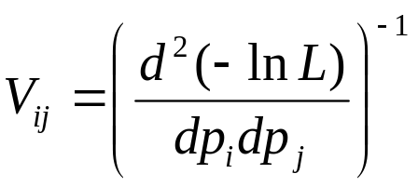
Minuit function HESSE
Purpose: calculate error matrix from
**********
** 18 **HESSE 1000
**********
COVARIANCE MATRIX CALCULATED SUCCESSFULLY
FCN=257.304 FROM HESSE STATUS=OK 10 CALLS 42 TOTAL
EDM=2.36534e-06 STRATEGY= 1 ERROR MATRIX ACCURATE
EXT PARAMETER INTERNAL INTERNAL
NO. NAME VALUE ERROR STEP SIZE VALUE
1 mean 8.84225e-02 3.23861e-01 7.16689e-05 8.84237e-03
2 sigma 3.20763e+00 2.39539e-01 5.57256e-05 3.26535e-01
ERR DEF= 0.5
EXTERNAL ERROR MATRIX. NDIM= 25 NPAR= 2 ERR DEF=0.5
1.049e-01 2.780e-04
2.780e-04 5.739e-02
PARAMETER CORRELATION COEFFICIENTS
NO. GLOBAL 1 2
1 0.00358 1.000 0.004
2 0.00358 0.004 1.000
Error matrix
(Covariance Matrix) calculated from

Slide 16
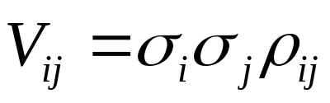
Minuit function HESSE
Purpose: calculate error matrix from
**********
** 18 **HESSE 1000
**********
COVARIANCE MATRIX CALCULATED SUCCESSFULLY
FCN=257.304 FROM HESSE STATUS=OK 10 CALLS 42 TOTAL
EDM=2.36534e-06 STRATEGY= 1 ERROR MATRIX ACCURATE
EXT PARAMETER INTERNAL INTERNAL
NO. NAME VALUE ERROR STEP SIZE VALUE
1 mean 8.84225e-02 3.23861e-01 7.16689e-05 8.84237e-03
2 sigma 3.20763e+00 2.39539e-01 5.57256e-05 3.26535e-01
ERR DEF= 0.5
EXTERNAL ERROR MATRIX. NDIM= 25 NPAR= 2 ERR DEF=0.5
1.049e-01 2.780e-04
2.780e-04 5.739e-02
PARAMETER CORRELATION COEFFICIENTS
NO. GLOBAL 1 2
1 0.00358 1.000 0.004
2 0.00358 0.004 1.000
Correlation matrix ρ_{ij}
calculated from

Slide 17
Minuit function HESSE
Purpose: calculate error matrix from
**********
** 18 **HESSE 1000
**********
COVARIANCE MATRIX CALCULATED SUCCESSFULLY
FCN=257.304 FROM HESSE STATUS=OK 10 CALLS 42 TOTAL
EDM=2.36534e-06 STRATEGY= 1 ERROR MATRIX ACCURATE
EXT PARAMETER INTERNAL INTERNAL
NO. NAME VALUE ERROR STEP SIZE VALUE
1 mean 8.84225e-02 3.23861e-01 7.16689e-05 8.84237e-03
2 sigma 3.20763e+00 2.39539e-01 5.57256e-05 3.26535e-01
ERR DEF= 0.5
EXTERNAL ERROR MATRIX. NDIM= 25 NPAR= 2 ERR DEF=0.5
1.049e-01 2.780e-04
2.780e-04 5.739e-02
PARAMETER CORRELATION COEFFICIENTS
NO. GLOBAL 1 2
1 0.00358 1.000 0.004
2 0.00358 0.004 1.000
Global correlation vector:
correlation of each parameter with all other parameters

Slide 18
Minuit function MINOS
Error analysis through Δnll contour finding
**********
** 23 **MINOS 1000
**********
FCN=257.304 FROM MINOS STATUS=SUCCESSFUL 52 CALLS 94 TOTAL
EDM=2.36534e-06 STRATEGY= 1 ERROR MATRIX ACCURATE
EXT PARAMETER PARABOLIC MINOS ERRORS
NO. NAME VALUE ERROR NEGATIVE POSITIVE
1 mean 8.84225e-02 3.23861e-01 -3.24688e-01 3.25391e-01
2 sigma 3.20763e+00 2.39539e-01 -2.23321e-01 2.58893e-01
ERR DEF= 0.5
Symmetric error
(repeated result from HESSE)
MINOS error
Can be asymmetric
(in this example the ‘sigma’ error is slightly asymmetric)
Wouter Verkerke, NIKHEF

Slide 19
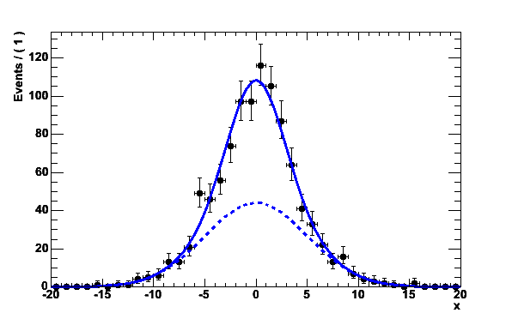
Mitigating fit stability problems
Strategy I – More orthogonal choice of parameters
  Example: fitting sum of 2 Gaussians of similar width
HESSE correlation matrix
PARAMETER CORRELATION COEFFICIENTS
NO. GLOBAL [ f] [ m] [s1] [s2]
[ f] 0.96973 1.000 -0.135 0.918 0.915
[ m] 0.14407 -0.135 1.000 -0.144 -0.114
[s1] 0.92762 0.918 -0.144 1.000 0.786
[s2] 0.92486 0.915 -0.114 0.786 1.000
Widths s₁,s₂
strongly correlated
fraction f

Slide 20
Mitigating fit stability problems
  Different parameterization:
  Correlation of width s2 and fraction f reduced from 0.92 to 0.68
  Choice of parameterization matters!
Strategy II – Fix all but one of the correlated parameters
  If floating parameters are highly correlated, some of them may be redundant and not contribute to additional degrees of freedom in your model
PARAMETER CORRELATION COEFFICIENTS
NO. GLOBAL [f] [m] [s1] [s2]
[ f] 0.96951 1.000 -0.134 0.917 -0.681
[ m] 0.14312 -0.134 1.000 -0.143 0.127
[s1] 0.98879 0.917 -0.143 1.000 -0.895
[s2] 0.96156 -0.681 0.127 -0.895 1.000

Slide 21
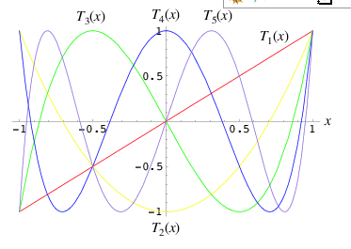
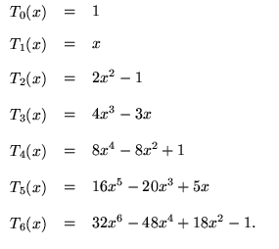
Fit stability with polynomials
Warning: Regular parameterization of polynomials a₀+a₁x+a₂x²+a₃x³ nearly always results in strong correlations between the coefficients a_{i}.
  Fit stability problems, inability to find right solution common at higher orders
Solution: Use existing parameterizations of polynomials that have (mostly) uncorrelated variables
  Example: Chebychev polynomials

Slide 22
Browsing fit results
As fits grow in complexity (e.g. 45 floating parameters),
number of output variables increases
  Need better way to navigate output that MINUIT screen dump
RooFitResult holds complete snapshot of fit results
  Constant parameters
  Initial and final values of floating parameters
  Global correlations & full correlation matrix
  Returned from RooAbsPdf::fitTo() when “r” option is supplied
Compact & verbose printing mode
Compact Mode
Constant
parameters
omitted in
compact mode
fitres->Print() ;
RooFitResult: min. NLL value: 1.6e+04, est. distance to min: 1.2e-05
Floating Parameter FinalValue +/- Error
-------------------- --------------------------
argpar -4.6855e-01 +/- 7.11e-02
g2frac 3.0652e-01 +/- 5.10e-03
mean1 7.0022e+00 +/- 7.11e-03
mean2 1.9971e+00 +/- 6.27e-03
sigma 2.9803e-01 +/- 4.00e-03
Alphabetical
parameter
listing

Slide 23
Browsing fit results
Verbose printing mode
fitres->Print(“v”) ;
RooFitResult: min. NLL value: 1.6e+04, est. distance to min: 1.2e-05
Constant Parameter Value
-------------------- ------------
cutoff 9.0000e+00
g1frac 3.0000e-01
Floating Parameter InitialValue FinalValue +/- Error GblCorr.
-------------------- ------------ -------------------------- --------
argpar -5.0000e-01 -4.6855e-01 +/- 7.11e-02 0.191895
g2frac 3.0000e-01 3.0652e-01 +/- 5.10e-03 0.293455
mean1 7.0000e+00 7.0022e+00 +/- 7.11e-03 0.113253
mean2 2.0000e+00 1.9971e+00 +/- 6.27e-03 0.100026
sigma 3.0000e-01 2.9803e-01 +/- 4.00e-03 0.276640
Constant parameters
listed separately
Initial,final value and global corr. listed side-by-side
Correlation matrix accessed separately

Slide 24
Browsing fit results
Easy navigation of correlation matrix
  Select single element or complete row by parameter name
RooFitResult persistable with ROOT I/O
  Save your batch fit results in a ROOT file and navigate
  your results just as easy afterwards
fitres->correlation("argpar","sigma")
(const Double_t)(-9.25606412005910845e-02)
fitres->correlation("mean1")->Print("v")
RooArgList::C[mean1,*]: (Owning contents)
1) RooRealVar::C[mean1,argpar] : 0.11064 C
2) RooRealVar::C[mean1,g2frac] : -0.0262487 C
3) RooRealVar::C[mean1,mean1] : 1.0000 C
4) RooRealVar::C[mean1,mean2] : -0.00632847 C
5) RooRealVar::C[mean1,sigma] : -0.0339814 C

Slide 25
References
RooFit online tutorial
  http://roofit.sourceforge.net/docs/tutorial/
  index.html
Credits:
  RooFit slides and examples extracted, adapted and/or inspired by original presentations by Wouter Verkerke

